Slide 1
Full Stack Application Development
Application Development- Introduction
Introduction to the Various Applications
Serverless Applications
Akshaya Ganesan

Slide 2
Serverless Applications

Slide 3
Serverless Application
Serverless architecture is an approach to software design that allows developers to build and run services without managing the underlying infrastructure.
Cloud service providers automatically provision, scale, and manage the infrastructure required to run the code.

Slide 4
Function as a Service
One of the most popular serverless architectures is Function as a Service (FaaS).
Developers write their application code as a set of discrete functions.
Each function will perform a specific task when triggered by an event.
When a function is invoked, the cloud provider executes the function.

Slide 5
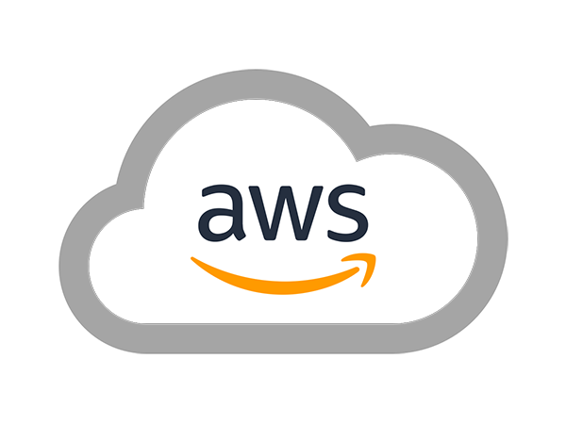

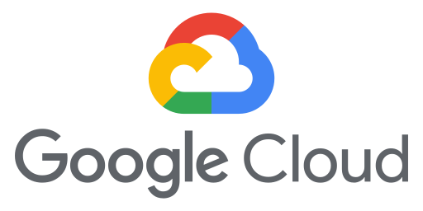
Function as a Service
The execution process is abstracted away from the view of developers.
Examples:
AWS: AWS Lambda
Microsoft Azure: Azure Functions
Google Cloud: Cloud Functions

Slide 6
Function as a Service
The execution process is abstracted away from the view of developers.
Examples:
AWS: AWS Lambda
Microsoft Azure: Azure Functions
Google Cloud: Cloud Functions

Slide 7
Serverless- Benefits and Drawbacks
Benefits
Drawbacks
Reduced operational cost
Loss of control
Easier operational management
Vendor lock-in
Multitenancy problems
Scalability
Security concerns

Slide 8
AWS Serverless
AWS provides a set of fully managed services that can be used to build and run serverless applications.
AWS Lambda
Allows to run code without provisioning or managing servers.
AWS Fargate
Purpose-built serverless compute engine for containers.
Amazon API Gateway
Fully managed service that makes it easy for developers to create, publish, maintain, monitor, and secure APIs at any scale.
Source : AWS Serverless

Slide 9
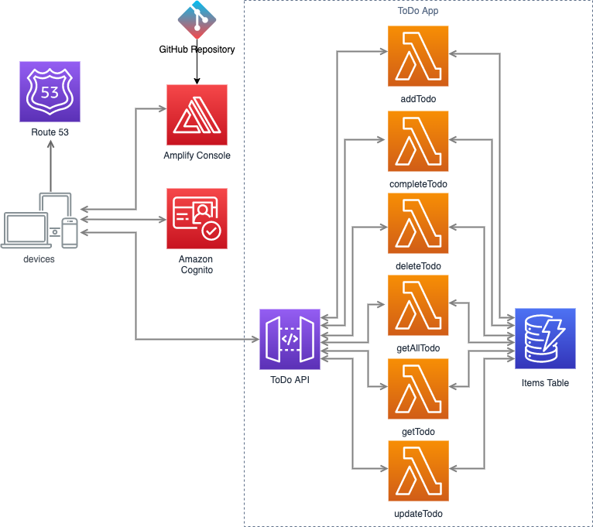
Example: AWS Serverless Architecture
General-purpose, event-driven, web application back-end that uses.
AWS Lambda, Amazon API Gateway for its business logic.
Uses Amazon DynamoDB as its database.
Uses Amazon Cognito for user management.
All static content is hosted using AWS Amplify Console.
Source : AWS

Slide 10
Serverless Applications
Source: Font: Arial, Font Size: 8 pts

Slide 11
Thank You!

